Slide 1

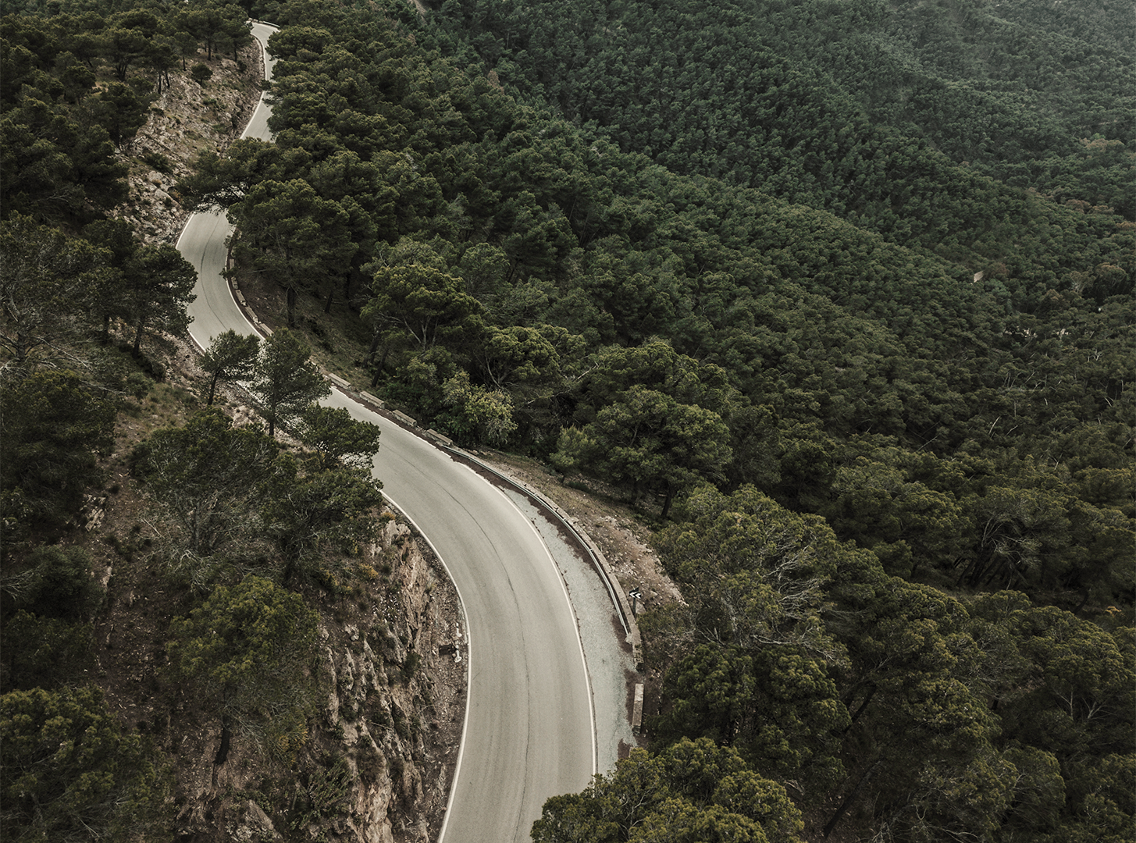

REDE DE TRANSPORTE DE DOENTES
João Vieira, 50458, 33,(3)% Lara Matos, 95228, 33,(3)% Vítor Santos, 107186, 33,(3)%
Interação Humano Computador
Ano letivo 2022/23

Slide 2
01
PROBLEM
02
03
TABLE OF CONTENTS
05
06
REQUIREMENTS
PAPER PROTOTYPE
04
ISSUES & DECISIONS
USABILITY EVALUATION
DEMO
07
CONCLUSIONS
2

Slide 3
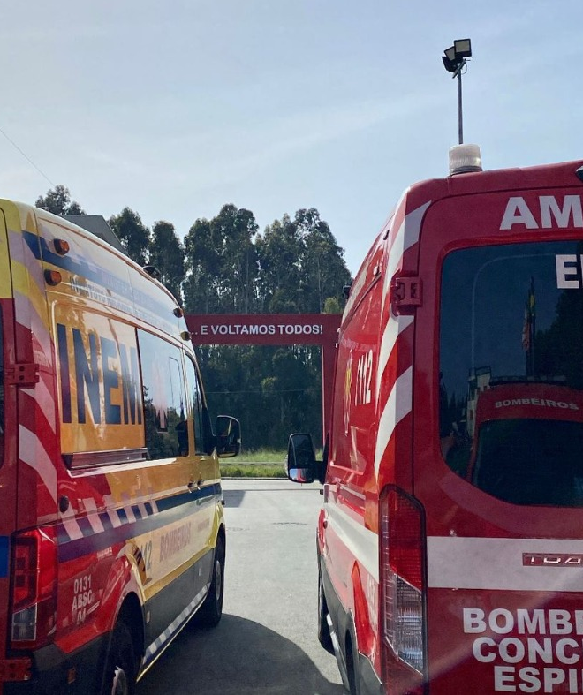




THE PROBLEM
01
Non-urgent patient transportation
Current methods are :​
Competitor System (SGTD) has several design flaws​
outdated, archaic and vague;​
costly.​
3

Slide 4
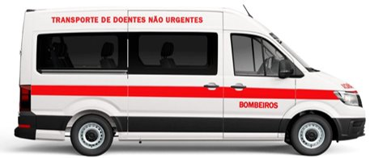
REDE DE TRANSPORTE DE DOENTES
01
Assist non-urgent patient transportation​
Human Centered Design
Accessibility
Efficiency
4

Slide 5
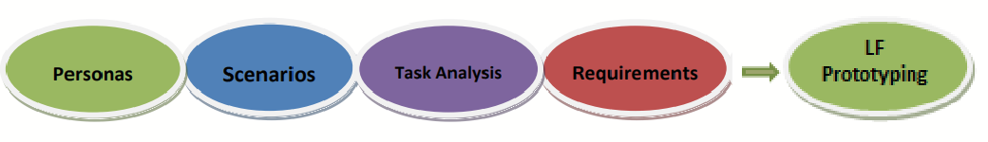
REQUIREMENTS METHODOLOGY
02
Goal-directed & activity-based
User research, informally interviewing:
Proxy users
Actual target users
Other user research (documentation)
5

Slide 6
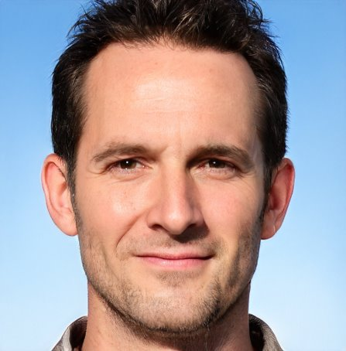
PERSONAS
02
Paulo Rodrigues Silva – Volunteer Firefighter
Age: 30 y
Schooling: Master's Degree
Tech Literacy: High
Occupation/Job: 1st Class Fireman
Experience: 5 y in Non-urgent Patients Transportation
Motivation: Wants a more efficient system to manage Non-urgent Patients Transportation
Approved by interviewed end-users and proxy users
6

Slide 7
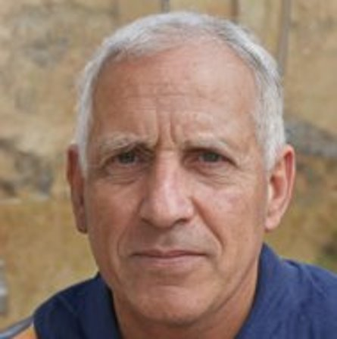
PERSONAS
02
Honório Bonifácio Rodrigues Serrano – Patient
Age: 84 y
Schooling: 4th grade basic education
Tech Literacy: Illiterate
Occupation: Retired – Miller (formerly)
Experience: 70 y as a Miller and Farmer
Motivation: Would like a way to be more independent in transportation using a simple and intuitive system.
7

Slide 8
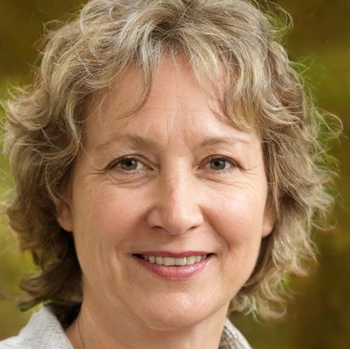
PERSONAS
02
Maria Luísa Serrano – Informal Caretaker
Age: 63 y
Schooling: Bachelor's Degree
Technological Literacy: Average
Occupation/Job: History Teacher (Basic School)
Experience: 35 y as a Teacher
Motivation: wishes she could have the means to arrange and manage transportation for her father's treatment sessions without affecting her job.
8

Slide 9
SCENARIOS
02
Scenario 1 – Scheduling transport – Mrs. Maria, Mr. Honório
Mr. Honório’s daughter (Mrs. Maria) doesn’t have the necessary conditions to transport her father to the hospital. So, Mrs. Maria Luísa will open the RTD app to schedule a transport with the local fire department. Mrs. Maria Luísa registers Mr. Honório’s data and do the scheduling that will be confirmed by the responsible for non-emergency patients’ transportation.
Scenario 2 – Patient delivery – Mrs. Maria, Mr. Honório, Mr. Paulo
The next patient firefighter Paulo will pick up is Mr. Honório. When he gets the patient’s data, he knows that Mr. Honório needs transportation with wheelchairs. The patient and his daughter are informed via SMS that Mr. Honório is the next person to recall and Mrs. Maria Luísa doesn’t need to miss work. After a few minutes, Mr. Honório is picked up by the firefighter Paulo and after 30 minutes, the non-urgent ambulance arrives at the hospital. Paulo updates the transport’s status and Mrs. Maria Luísa receives a notification that his father arrived at the hospital safely.
9

Slide 10
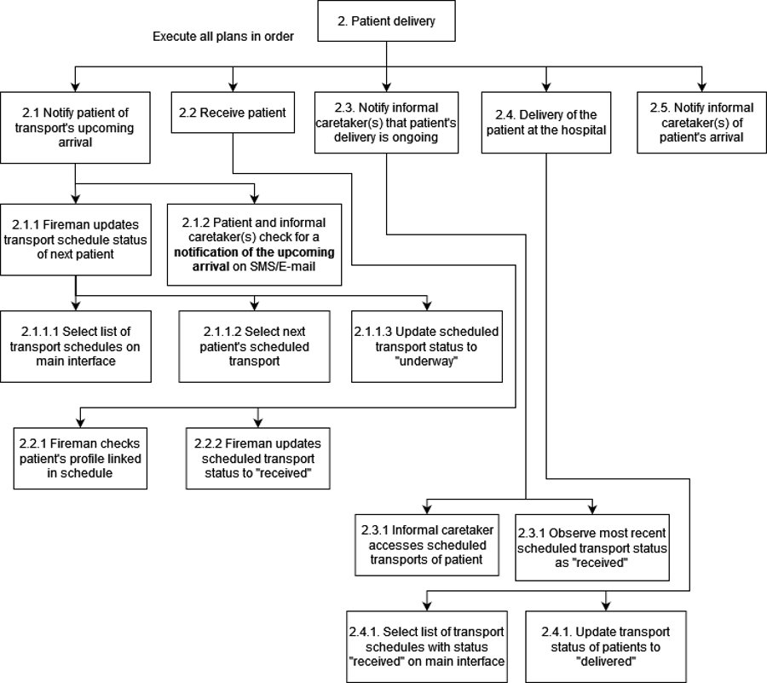
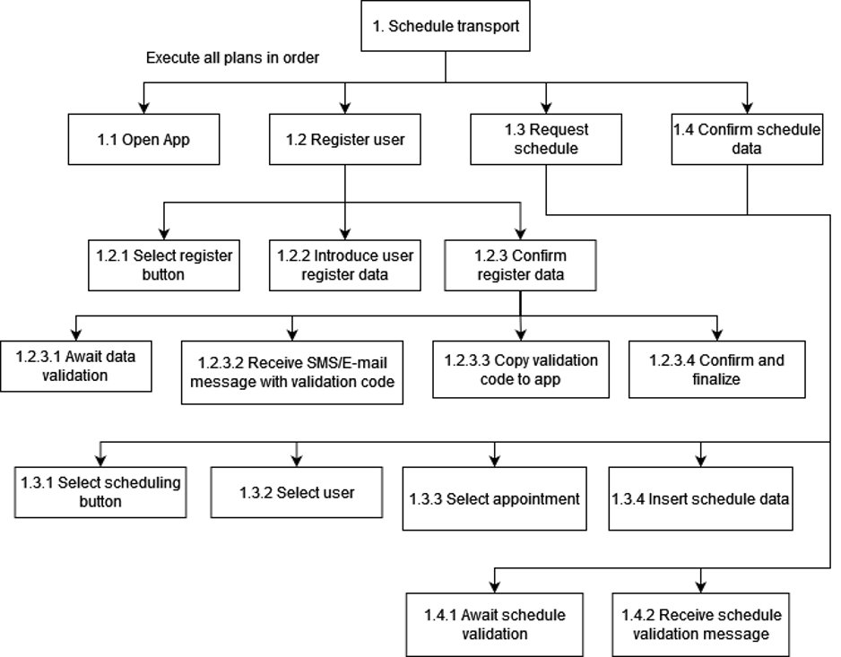
TASKS
02
10

Slide 11


REQUIREMENTS
02
Non-functional
Modular & Extensible
Easy to maintain and manage
Robust
Effective & Efficient
Applicable to most mobile systems
Accessible even in remote rural areas
Highly intuitive
Functional
Allow transport scheduling
Display waiting time (queue)
Display patient medical history
Allow some user info update (address, mobility, transportation requirements)
Interconnected systems for patients & informal caregiver
INITIALLY PLANNED but DISCARDED (not in Scenarios)
Video Calls
Literacy adaptable
GPS Tracking system
Family doctor contact
Interactive narrated FAQ
11

Slide 12
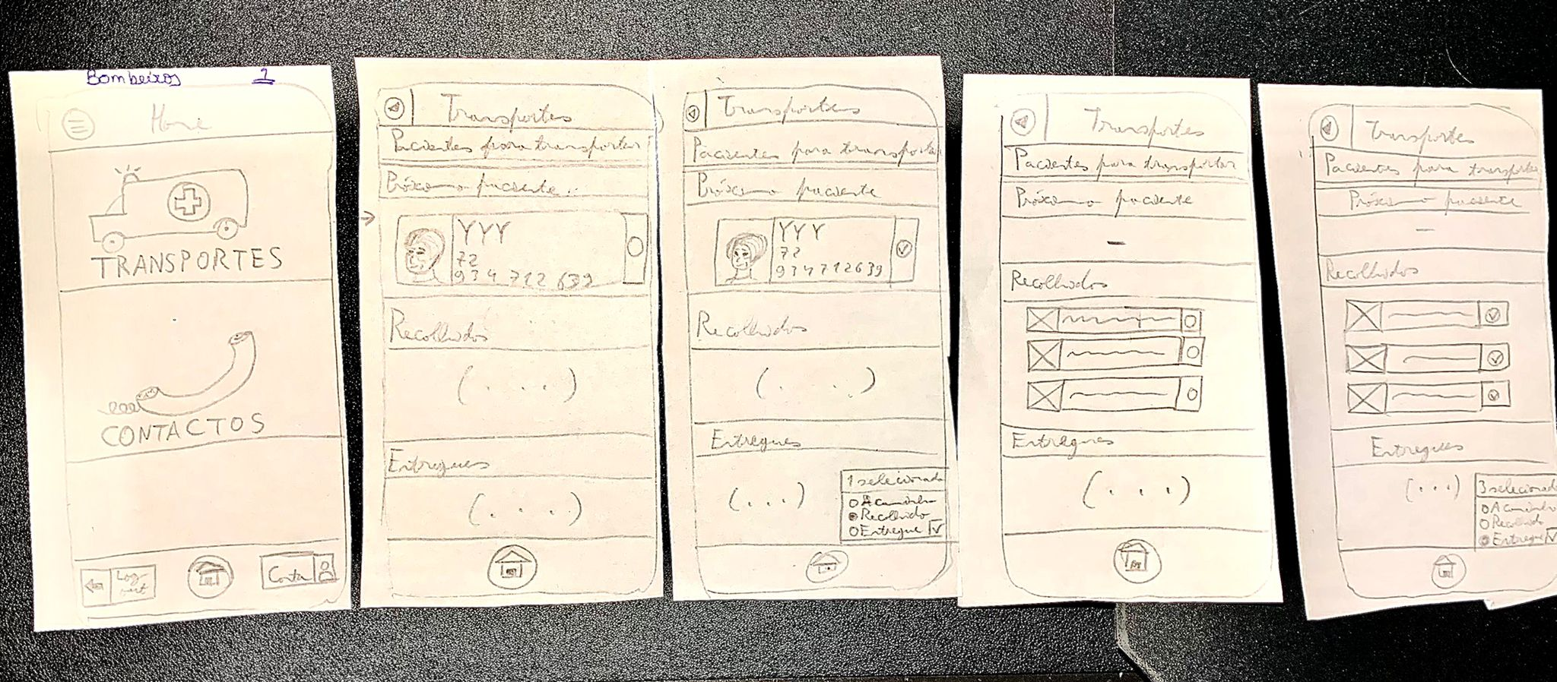
PAPER PROTOTYPE
03
Based on prev. Requirement Analysis and Nielsen's 10 usability heuristics.
12

Slide 13
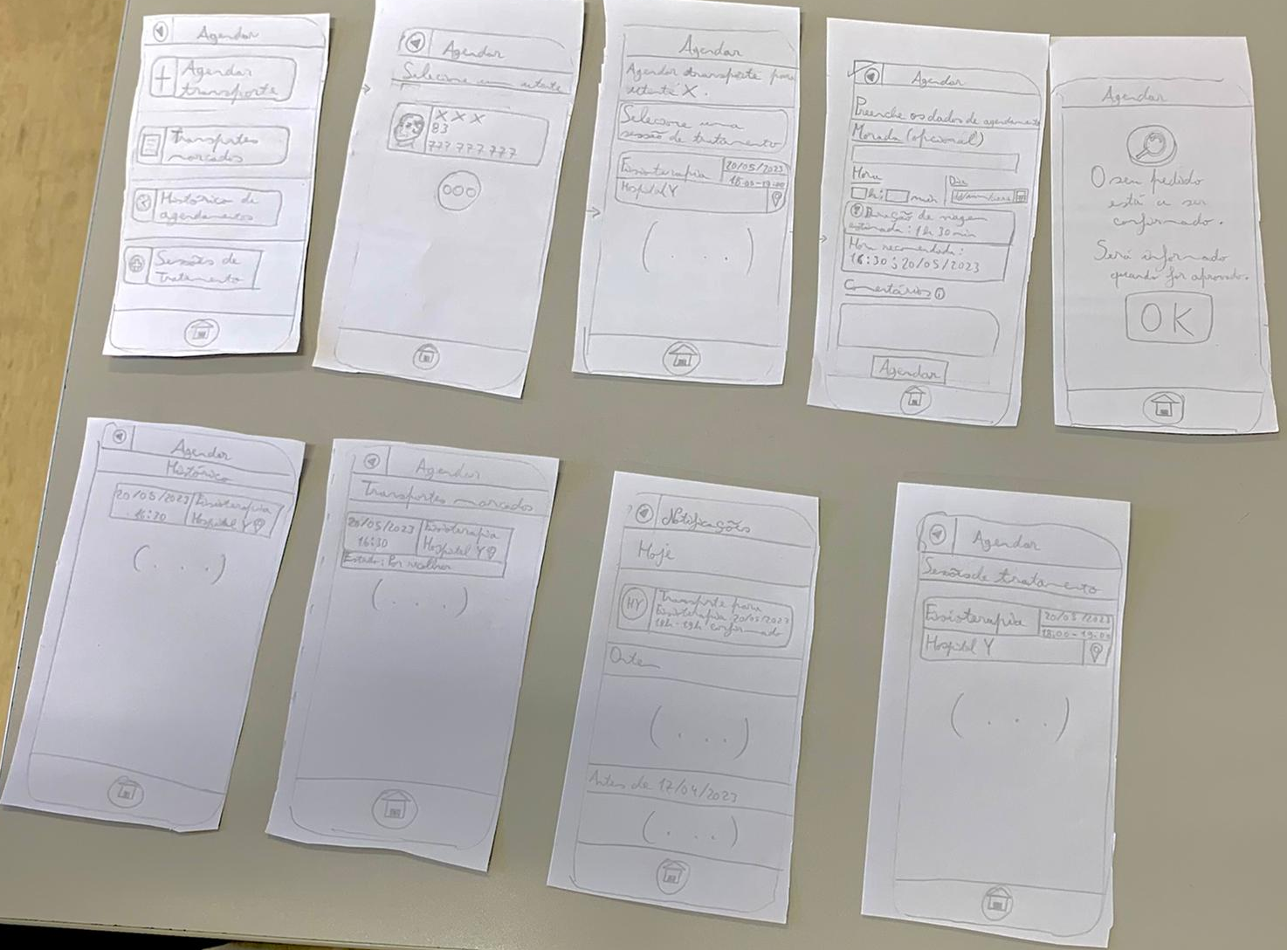
PAPER PROTOTYPE
03
13

Slide 14





ISSUES & DECISIONS
04
Paper prototype
Unclear word semantics
Lack of color
Visually indistinct, yet functionally very distinct UI elements
Some illegible words
Elderly very uninterested
Opted for 2 main UI groups
Firefighter – functionally very distinct from patient/informal caretaker.
Patient/Informal Caretaker – tasks performed by both roles are very similar.
Latter group biased toward patient accessibility
Functional prototype
Development in Flutter (easy platform independence)
Firebase integration suggested but pushed aside for production app development.
Initially highly static
Some holes in functionality
14

Slide 15
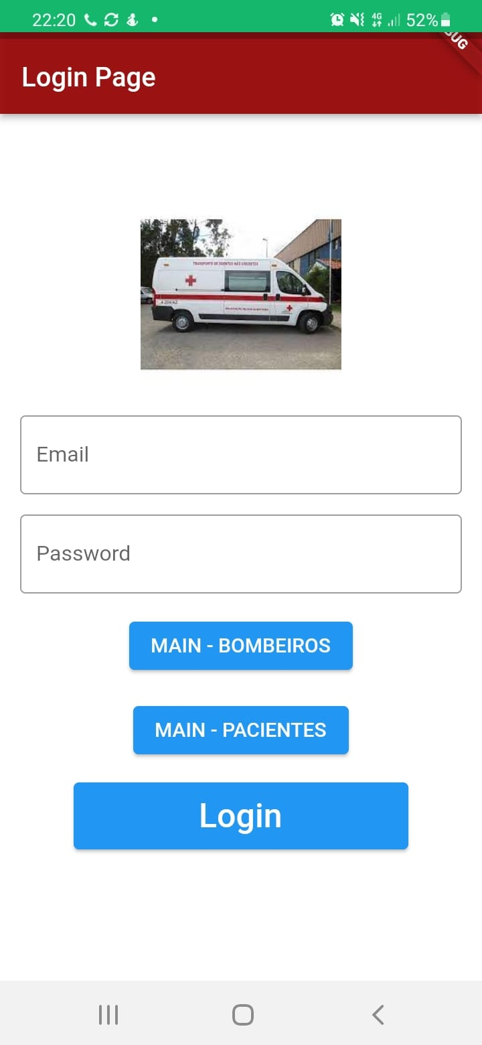
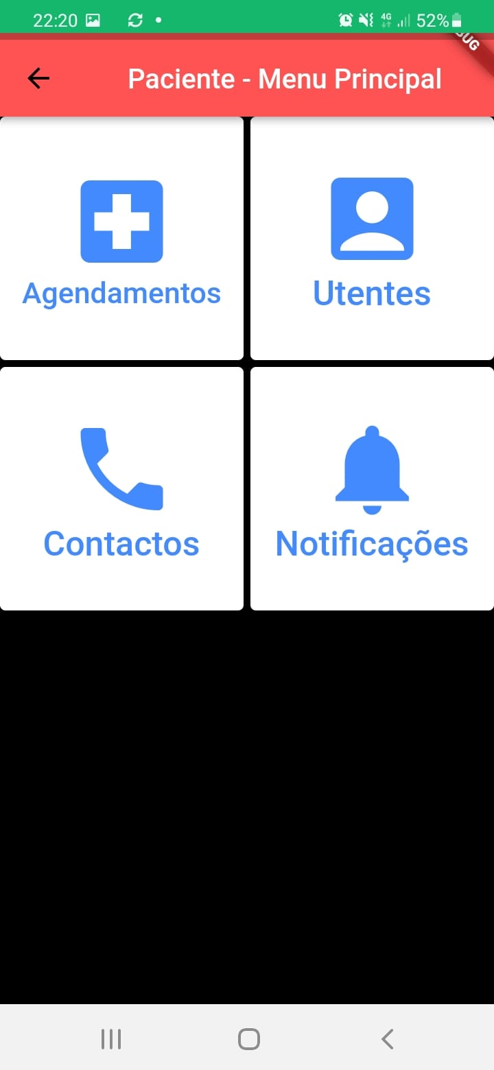
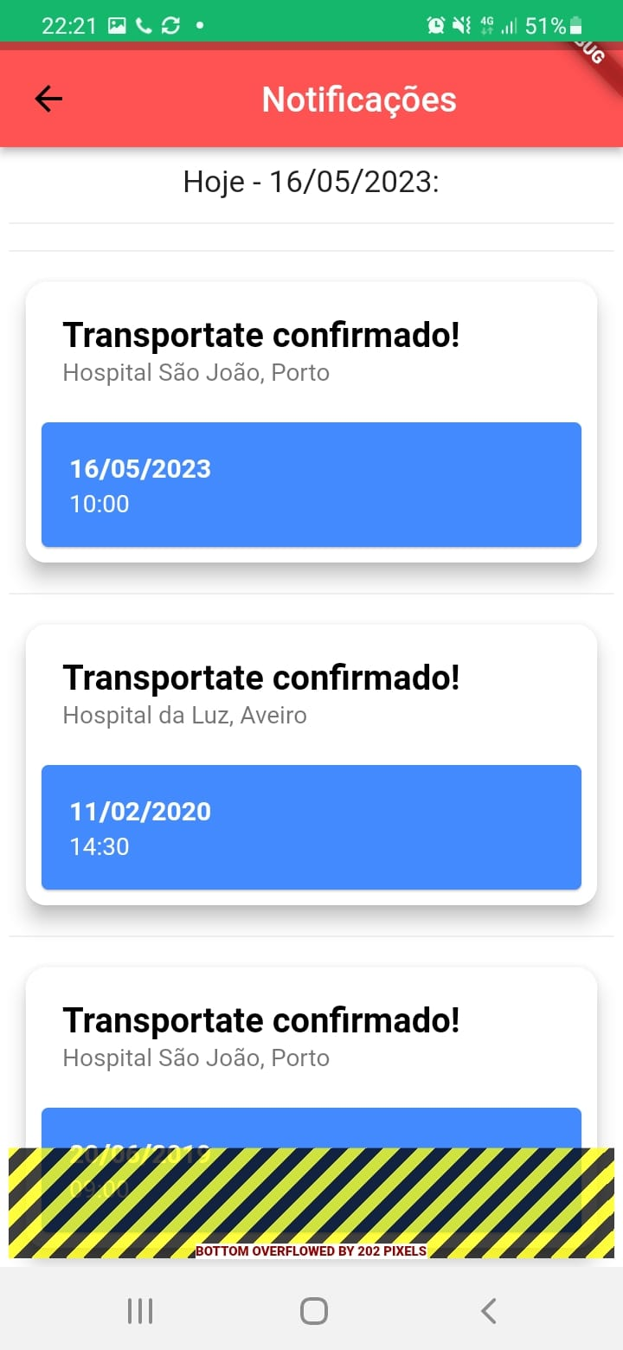
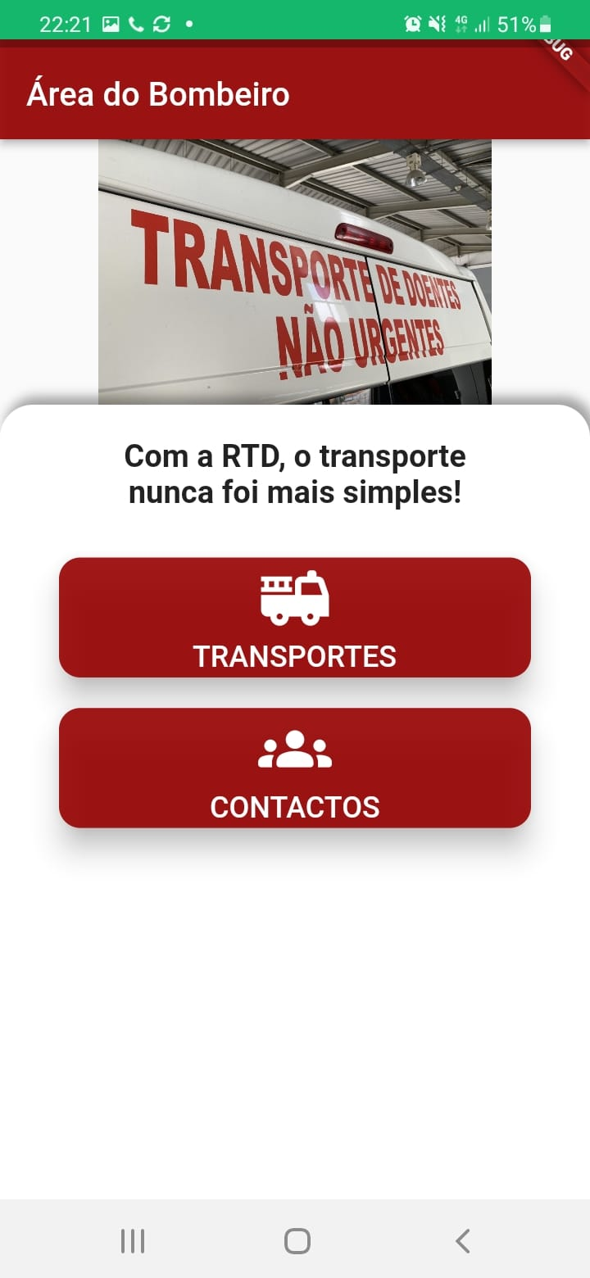
PROTOTYPE
07
15

Slide 16
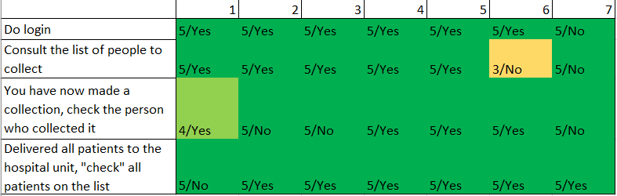
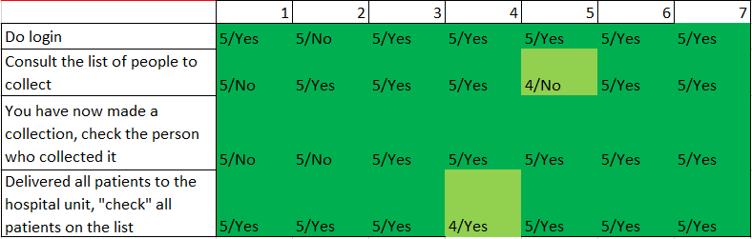
Usability Tests
05
FIREFIGHTER
Legend:
Difficulty scale: 1-Not easy-> 5-Very easy
Completed the task with autonomy: Yes/No
16

Slide 17
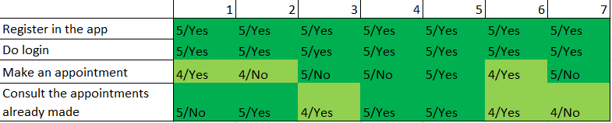
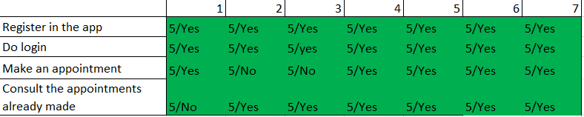
05
Usability Tests
INFORMAL CAREGIVER / PATIENT
Legend:
Difficulty scale: 1-Not easy-> 5-Very easy
Completed the task with autonomy: Yes/No
17

Slide 18
Post-Tasks Questionnaire
05
Number | Sentences
1 | I found the prototype aesthetically appealing
2 | I found the prototype aesthetically complex
3 | I found the program easy to use
4 | I think this program will create conflicts with the authorities
5 | If I were an informal caregiver, I would use this application
6 | I think this mechanism is unnecessary for the transport of non-urgent patients
7 | If I were an elderly person in need of transport, I would use this application
8 | I think I would need support to use this application
9 | I feel confident using the program
10 | I think the program tools are not adequate
18

Slide 19
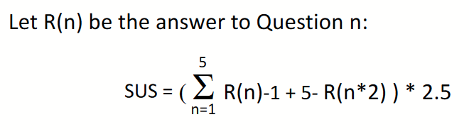

SUS Evaluation
05
 | User 1 | User 2 | User 3 | User 4 | User 5 | User 6 | User 7
1 | 4 | 2 | 5 | 5 | 4 | 5 | 5
2 | 2 | 2 | 2 | 1 | 3 | 1 | 2
3 | 5 | 5 | 5 | 5 | 5 | 5 | 5
4 | 1 | 1 | 1 | 1 | 2 | 1 | 1
5 | 5 | 4 | 1 | 5 | 5 | 5 | 5
6 | 2 | 1 | 3 | 1 | 1 | 1 | 1
7 | 5 | 5 | 5 | 5 | 5 | 5 | 4
8 | 1 | 1 | 2 | 1 | 2 | 1 | 1
9 | 5 | 5 | 4 | 5 | 5 | 5 | 5
10 | 1 | 1 | 1 | 1 | 2 | 1 | 1
ODD | 24 | 21 | 20 | 25 | 24 | 25 | 24
PAIR | 7 | 6 | 9 | 5 | 10 | 5 | 6
X | 19 | 16 | 15 | 20 | 19 | 20 | 19
Y | 18 | 19 | 16 | 20 | 15 | 20 | 19
INDIVIDUAL SUS SCORE | 92,5 | 87,5 | 77,5 | 100 | 85 | 100 | 95
TOTAL SUS SCORE | 91,05
19

Slide 20

HEURISTIC EVALUATION
05
Issues found (median)
– aided by HCI colleagues Diogo Marto 108546, Tiago Pereira 108298 from practical class P5
Little help and documentation resources – Severity: 2 – Help and documentation
Patient information cards lack a photograph – Severity: 2 – Recognition rather than recall
Font size not adjustable – Severity: 2 – Visibility, Control
Mostly positive evaluation
20

Slide 21


FINAL APPLICATION
06
Short-term objectives
Adaptable for illiterate people
Intuitive for the elderly
Applicable to most Android systems
Long-term goals
Intuitive to all age groups
Effective and efficient across the country
Robust & easy to manage
Highly modular & extensible
Frontend development using Flutter:
Extensible, modular, platform-independent
Backend development using Firebase:
Rich family of integrations (ex.: Android Studio, Google Cloud, Google Play)
App analytics monitor (enrich future empirical usability evaluations)
21

Slide 22
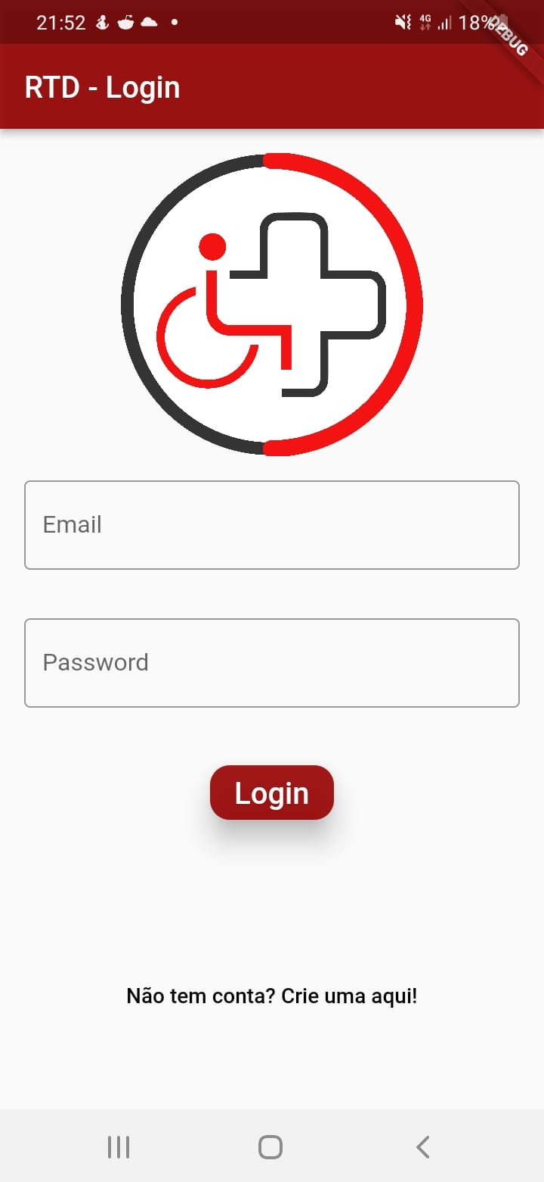
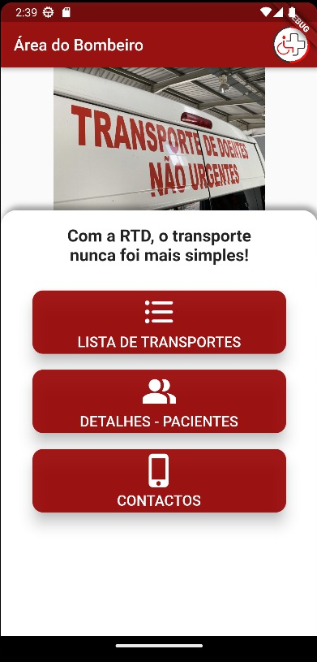
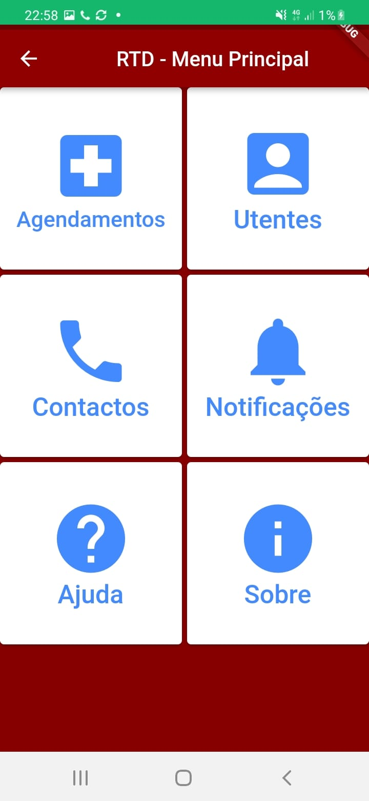
REFINEMENT
07
22

Slide 23
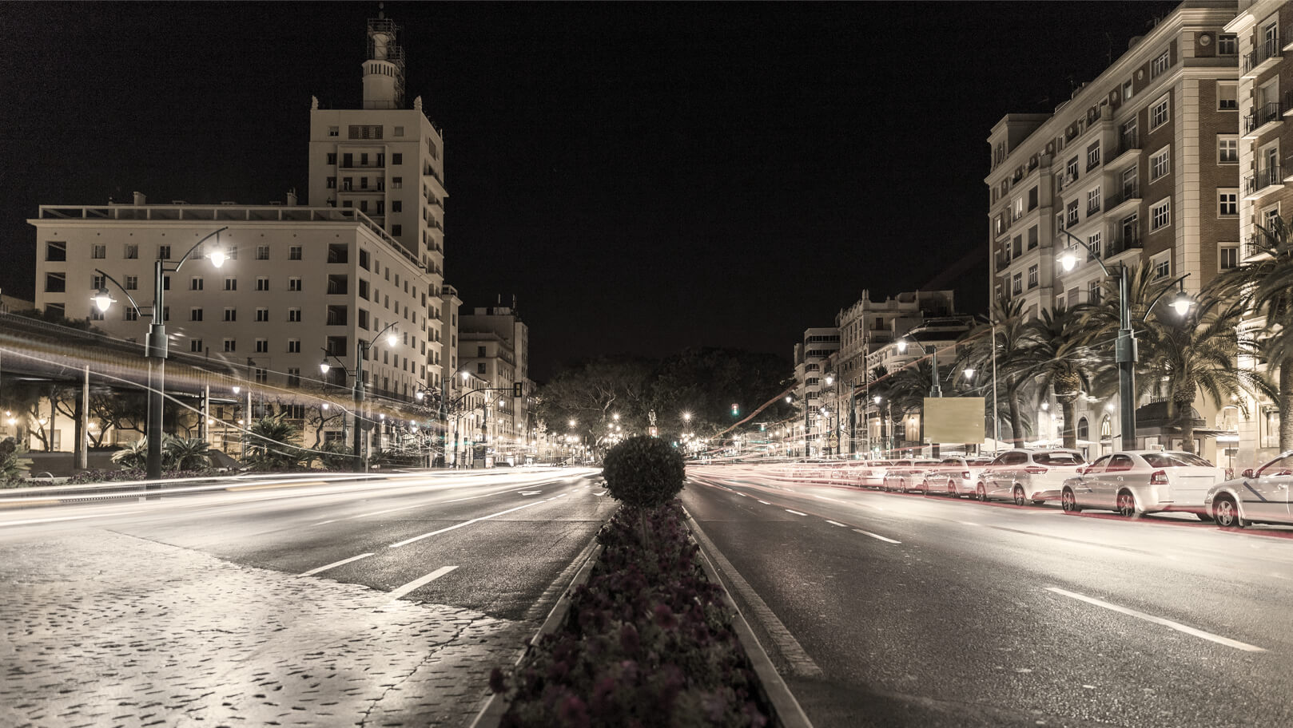
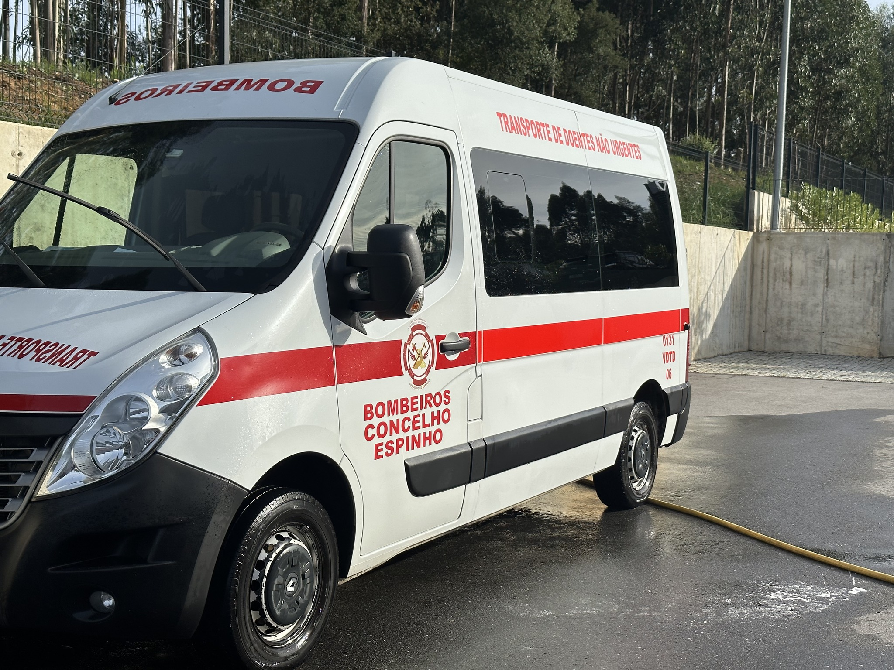
DEMO

Slide 24

CONCLUSIONS & FUTURE WORK
08
Applicability
Informal caregiver's & people with reduced mobility may find this app useful.
Today's elderly population do not understand how to use the app.
However, future generations will.
App will improve
Firefighter's coordination.
Patient's independence.
Informal caregiver's freedom.
Overall quality of life in Portugal
Future Work
More research is needed for (tech) illiterate people.
Develop tools for people with disabilities (ex.: blind)
Development of a GPS tracker may be useful
Connect to a real SQL Data Base or Firebase
24

Slide 25



REFERENCES
Presentation Assets:
Presentation template by Slidesgo​
Icons by Flaticon​
Infographics by Freepik​
Images created by Freepik​
Development Resources:
Android Studio IDE
Flutter framework
Flutter templates
Flutter projects
HCD Research:
HCI course slides & respective references
25

Slide 26


OUR GITHUB
https://github.com/laramatos22/ihc_project
https://rtd-ihc2023-ua.atlassian.net/jira/software/projects/RTD/boards/1
26

